Slide 1
GAS LEVEL MONITORING SYSTEM
G Jhansi Lakshmi
G Nikitha
A Chetana
Akhil

Slide 2

Introduction to Gas Level Monitoring Using IoT
IoT-based gas level monitoring is a revolutionary approach to tracking and managing gas levels in various environments. It combines advanced sensor technology, wireless connectivity, and data analytics to provide real-time insights, enabling businesses and individuals to make informed decisions and enhance safety.

Slide 3

Importance of Gas Level Monitoring
1
Safety
2
Efficiency
3
Compliance
Continuous monitoring of gas levels helps identify and mitigate potential hazards, protecting lives and property.
Optimized gas usage and distribution leads to cost savings and reduced environmental impact.
IoT-based systems ensure adherence to regulatory guidelines and industry standards for gas management.

Slide 4
Challenges in Traditional Gas Level Monitoring
Limited Visibility
Inefficient Processes
Lack of Scalability
Traditional methods rely on manual checks, providing limited real-time data and making it difficult to identify issues promptly.
Manual monitoring and data collection are labor-intensive, time-consuming, and prone to human errors.
Traditional systems struggle to accommodate the growing demand for comprehensive gas level monitoring across multiple sites and locations.

Slide 5
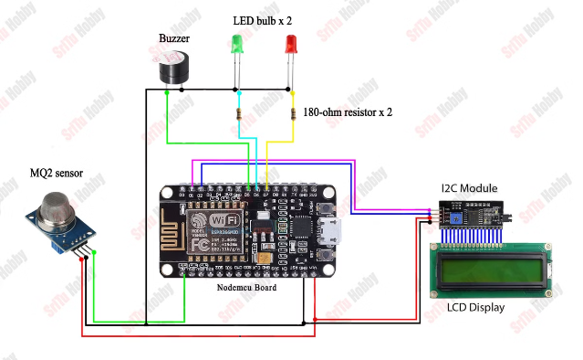
Circuit diagram

Slide 6

Benefits of IoT-based Gas Level Monitoring
Real-time Insights
Cost Savings
IoT systems provide continuous, real-time data on gas levels, enabling faster response times and data-driven decision-making.
Optimized gas usage and predictive maintenance reduce operational costs and improve overall efficiency.
Enhanced Safety
Remote Accessibility
Early detection of gas leaks or abnormal levels helps mitigate risks and protect people and assets.
IoT-based monitoring allows for remote access and control, eliminating the need for on-site personnel.

Slide 7

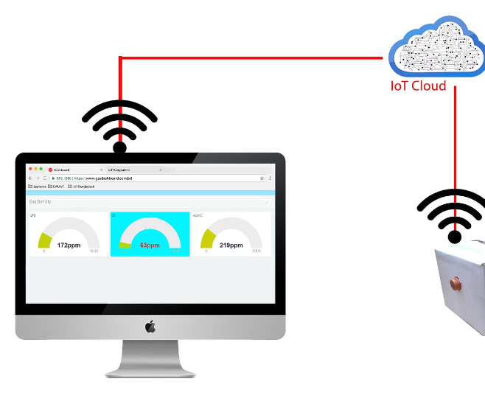
Components of an IoT-based Gas Level Monitoring System
1
Sensors
Strategically placed gas sensors that detect and measure the levels of specific gases in the environment.
2
Data Aggregation
Devices that collect and consolidate the sensor data for further processing and analysis.
3
Connectivity
Wireless communication protocols that transmit the data from the sensors to the cloud or a central monitoring system.

Slide 8
Sensor Selection and Placement
Sensor Types
Sensor Placement
Calibration
Careful selection of gas sensors based on the specific gases, concentration ranges, and environmental conditions.
Strategic positioning of sensors to ensure accurate and comprehensive monitoring of the target area.
Regular calibration and maintenance of sensors to ensure reliable and consistent data collection.

Slide 9

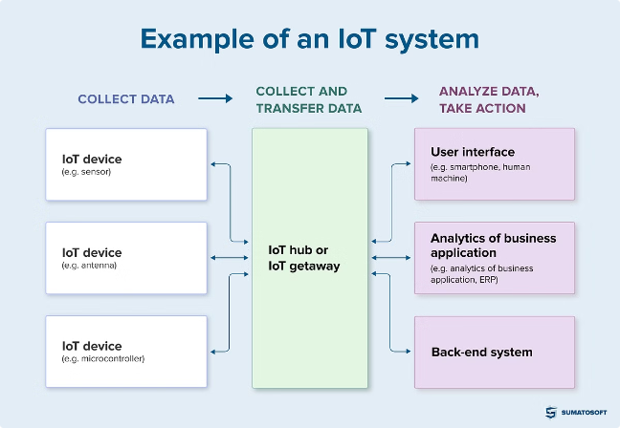



Data Collection and Transmission
Sensor Data
Continuous monitoring and real-time data collection from the gas sensors.
Data Aggregation
Consolidation of sensor data by gateway devices or edge computing platforms.
Cloud Transmission
Secure and reliable transmission of the aggregated data to the cloud or a centralized monitoring system.

Slide 10


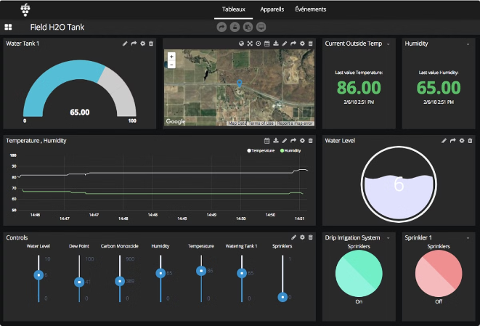


Data Analysis and Visualization
Data Analytics
Advanced algorithms and machine learning models to identify patterns, trends, and anomalies in the gas level data.
Visualization
Interactive dashboards and reports that provide clear, intuitive insights for decision-makers.
Alerts and Notifications
Real-time alerts and notifications to promptly identify and respond to critical gas level changes.

Slide 11

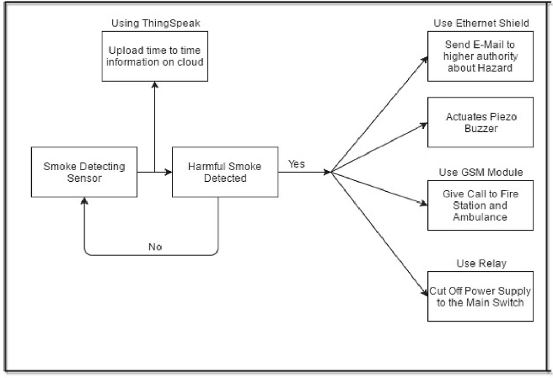
Real-World Applications and Case Studies
1
Industrial Facilities
Monitoring and optimizing gas usage in manufacturing plants, refineries, and chemical plants.
2
Smart Buildings
Enhancing energy efficiency and safety by monitoring gas levels in commercial and residential buildings.
3
Transportation
Tracking and managing fuel levels in vehicles and transportation hubs to improve logistics and operations.
4
Agriculture
Monitoring greenhouse gas levels and soil composition to optimize crop production and sustainability.

Slide 12
Conclusion and Future Considerations
Continued Innovation
Integrated Solutions
Sustainability Focus
Advancements in sensor technology, data analytics, and connectivity will drive the evolution of IoT-based gas level monitoring.
Seamless integration of gas level monitoring with other IoT systems for comprehensive facility management and optimization.
Increased emphasis on reducing greenhouse gas emissions and promoting environmentally-friendly gas usage practices.

Slide 13


